Slide 1
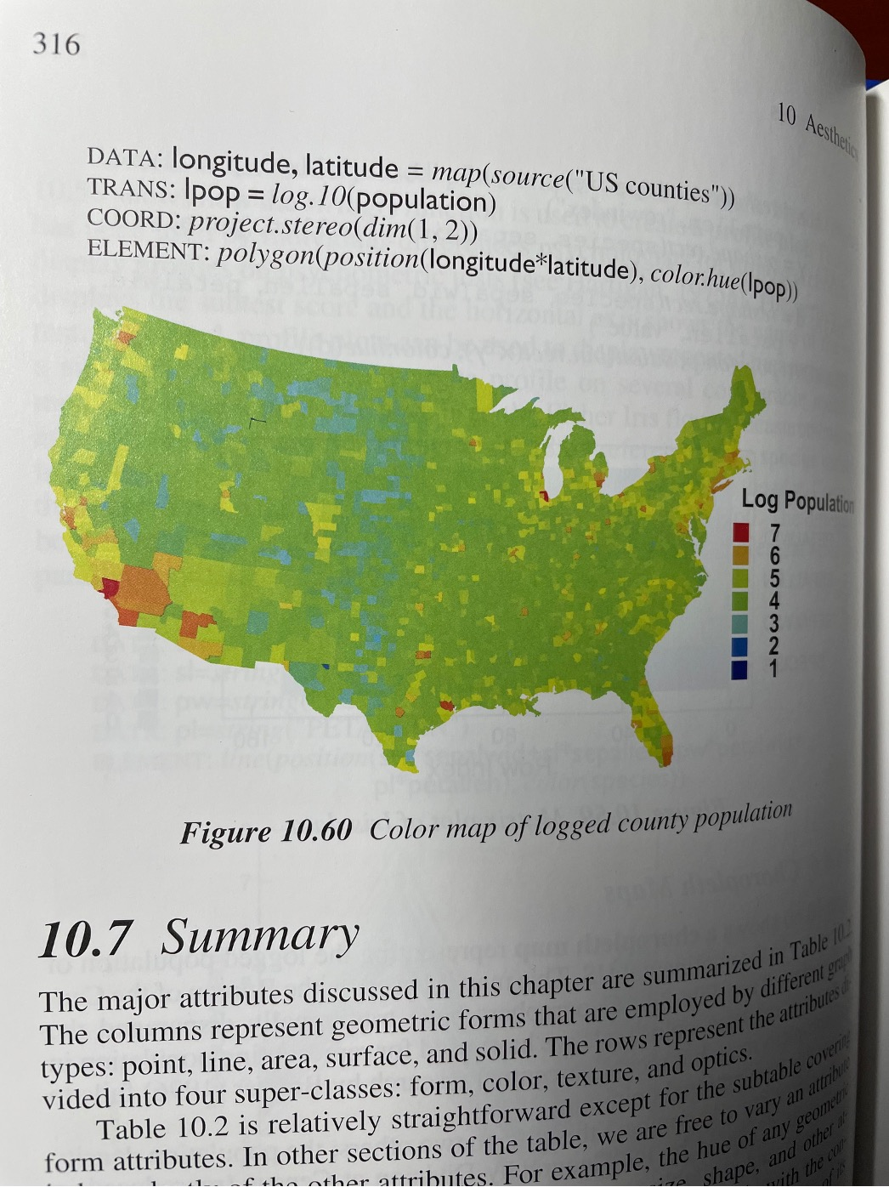
What about the spectrum?
Wilkinson’s Grammar of Graphics…
(If a referee comments on your color choices, it is probably me.)

Slide 2
All maps of 2010
population density:
We can choose breaks to highlight cities.
Quantiles start to show Tufte’s “ghastly rainbow”
Quantiles using saturation rather than the spectrum is much easier to read…
Legend should be a reference,
not a required key for decoding…

Slide 3
Maps Integrate (Maps as data)

Slide 4
Geometric Space and Geographic Space
Geometric Space
Distance, direction, movement
Dimensions
Geometry
Geographic Space
Links location to observations, experiences, knowledge
Added value: Generates new ideas/hypotheses

Slide 5
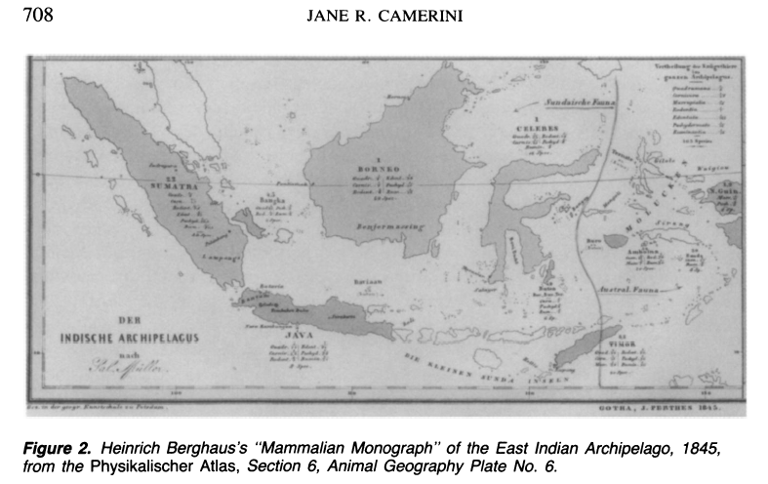
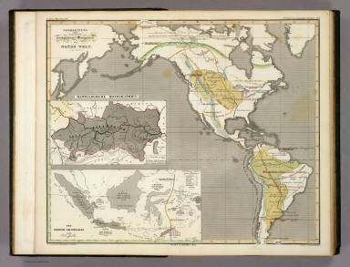
Berghaus, 1845
Camerini JR (1993) Evolution, biogeography, and Maps: An early history of Wallace’s Line. Isis 84, 700-727.

Slide 6
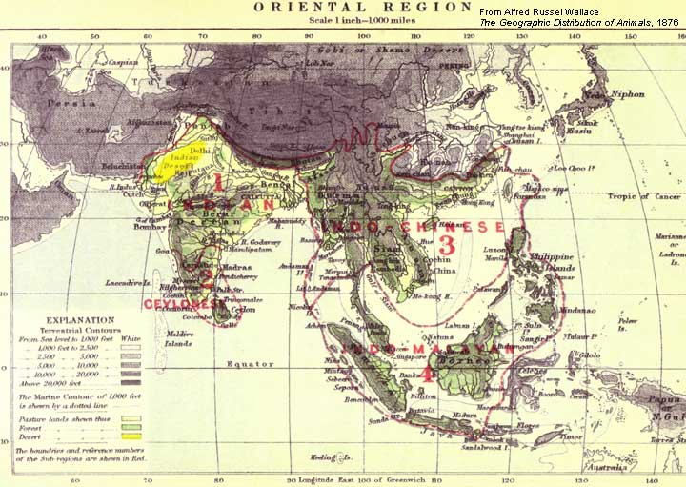
Wallace Line, 1859

Slide 7
Geometric Space and Geographic Space
Geometric Space
Can provide summaries and correlations
Geographic Space
Provides opportunity to interpret summaries and correlations respect to a place.

Slide 8
Geographic information systems
Cases
Joining:
Link datasets by location
Exposures
Controls
Layering
Buffering

Slide 9
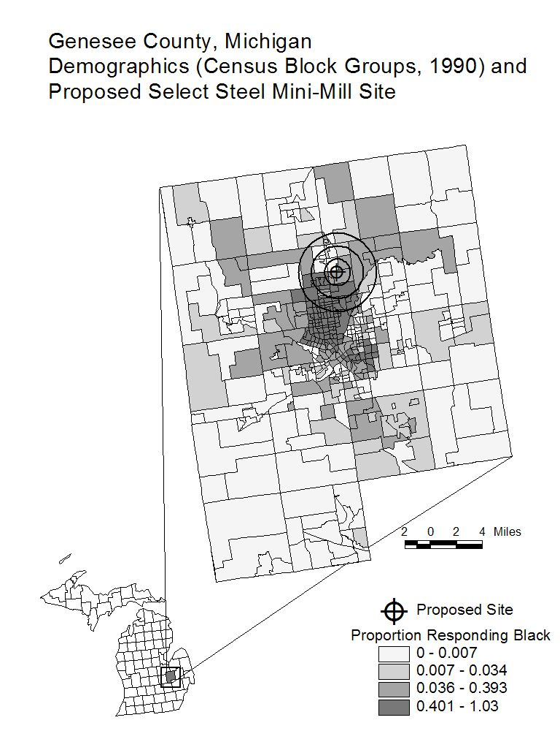
Example: Environmental Justice, Flint Michgan
Complaint filed with the EPA: “the vast majority of the people within 3 miles of the proposed site are minority Americans and will be burdened with a disparate impact of pollution in an already deeply polluted area.”
Detroit News: “overwhelmingly white makeup of the surrounding neighborhood’s demographics” and based on data for the neighborhood within a one-mile radius around the proposed site.

Slide 10
But…
Not all interpretations are correct
Yellow fever, miasma, and mosquitos
Parkes interpretation of Snow’s map
How does statistical inference work on maps?

Slide 11
Maps Evaluate (Maps as Statistics)

Slide 12
Inference in Geographic Space
Statistical inference
Often based on independent, identically distributed observations.
Same mean
Same variance
Estimates converge as sample size grows (asymptotics).
Simple random sampling
What’s different in spatial data?
Not i.i.d. (Spatial correlation, different means and variances)
Asymptotics (What goes to infinity? How?)
Sampling (From where do I need more information?)

Slide 13
Three examples
Small area estimation:
Tension between geographic, statistical, privacy precision
Random effects, priors, and penalties
Spatially varying associations:
Geographically weighted regression and random slopes
Spatial diagnostics for spatial models:
The Geography of Power
Local measures of model fit

Slide 14
Geographic, statistical, privacy precision
Geographic precision: Want map with lots of detail (small regions)
Statistical precision: Want map with narrow interval estimates for local estimates (large sample sizes)
How do we get large sample sizes?
Privacy precision: Map to identify patterns but not individuals.

Slide 15
Statistical
Accuracy
and Precision
Bias/Variance
Tradeoff
Pool more information
Inject more noise
Pool less information
Inject less noise
Geographical
Accuracy
and Precision
Disease
Mapping
Fewer local/subgroup constraints: Global DP
Privacy
Differential
Privacy
Small
Area
Estimation
Subgroup
Accuracy
and Precision
More local constraints: Geographic DP?

Slide 16
Geographical, statistical compromise
Small area estimation
Fay and Herriot (1979, JASA)
James-Stein estimation
Compromise between local estimate and global estimate.
Disease mapping
Clayton and Kaldor (1987, Biometrics), Besag, York and Mollié (1991)
Compromise between local estimate, estimates from neighbors.
Classic design/model hybrid
“Design what you can, model the rest.”
Implemented via random effects

Slide 17
How do random effects work?
What can spatial data settings teach us about foundations of statistical inference? (I need for things to make sense).

Slide 18
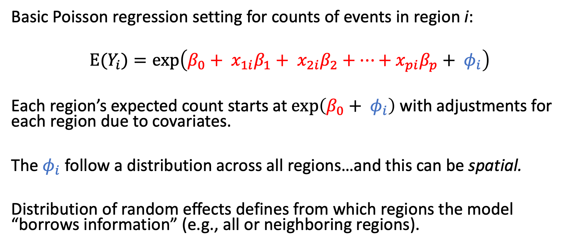
Typical Poisson regression setting
Basic Poisson regression setting for counts of events in region i:
$${E(Y}_{i})=exp\left(β_{0}+ x_{1i}β_{1}+ x_{2i}β_{2}+…+x_{pi}β_{p}+ φ_{i}\right)$$
Each region’s expected count starts at $exp\left(β_{0}+ φ_{i}\right)$ with adjustments for each region due to covariates.
The $φ_{i}$ follow a distribution across all regions…and this can be spatial.
Distribution of random effects defines from which regions the model “borrows information” (e.g., all or neighboring regions).

Slide 19
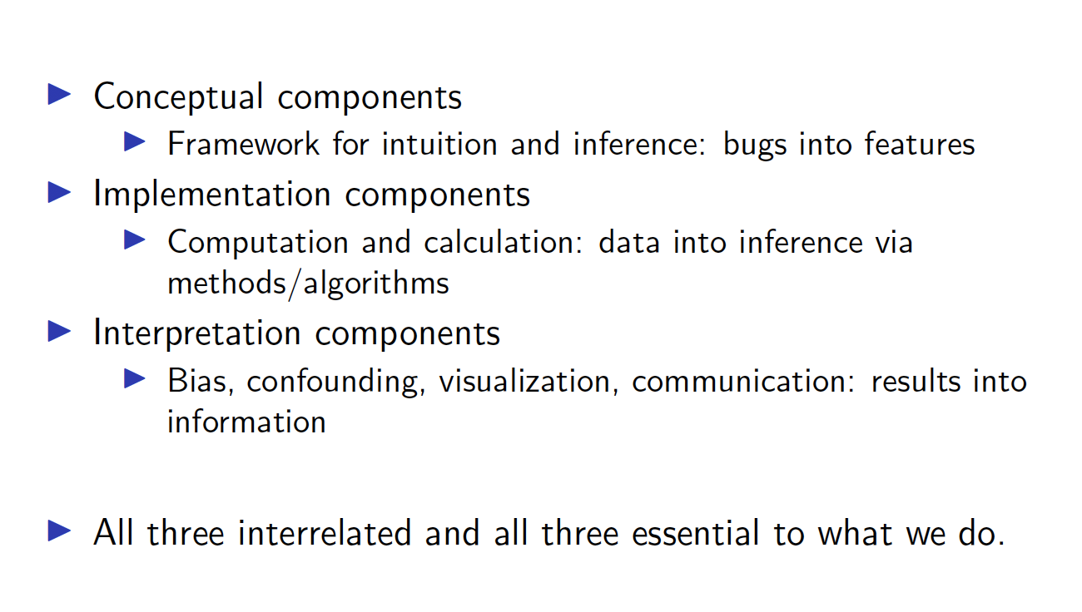
Three components to statistical inference

Slide 20
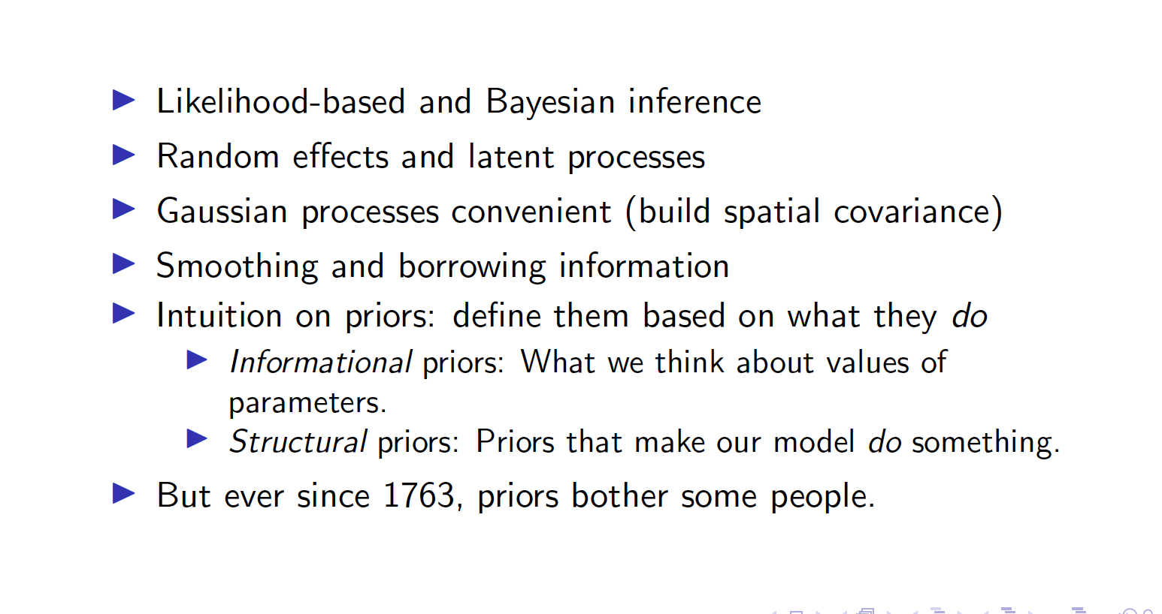
Conceptual components of spatial statistics

Slide 21
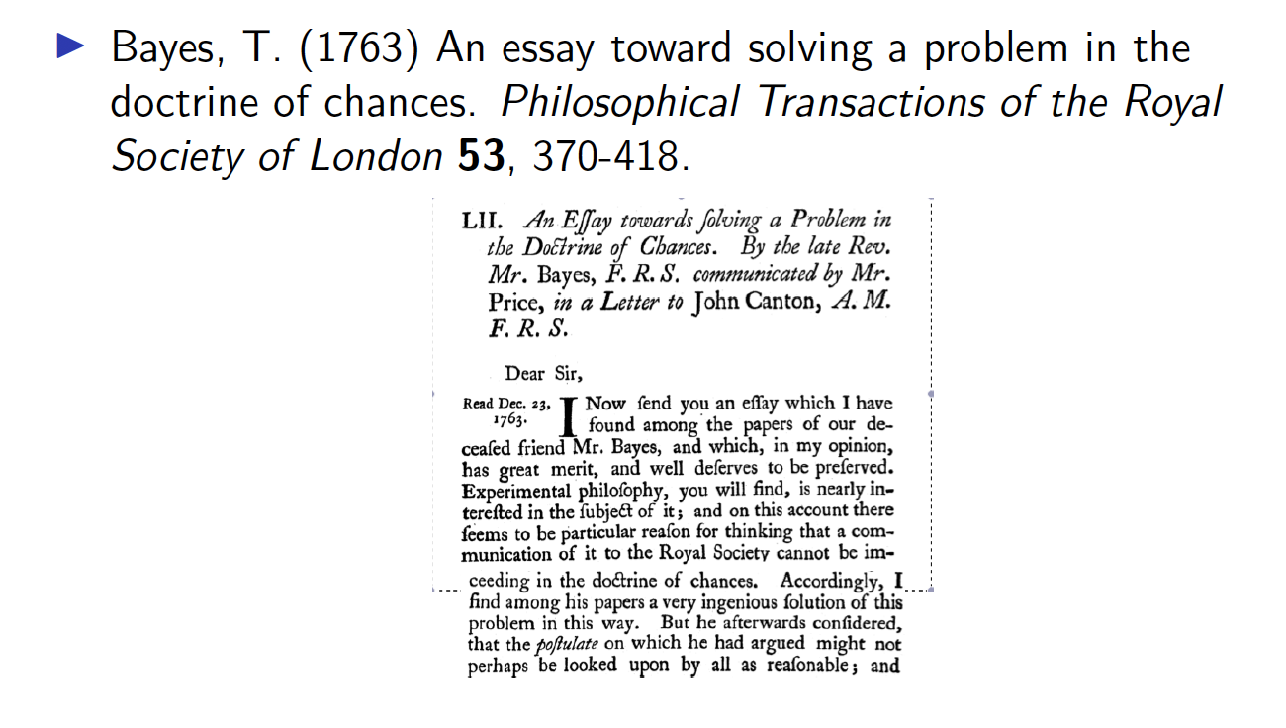
Background: Bayes (1763)

Slide 22

Consulting the good Reverend

Slide 23
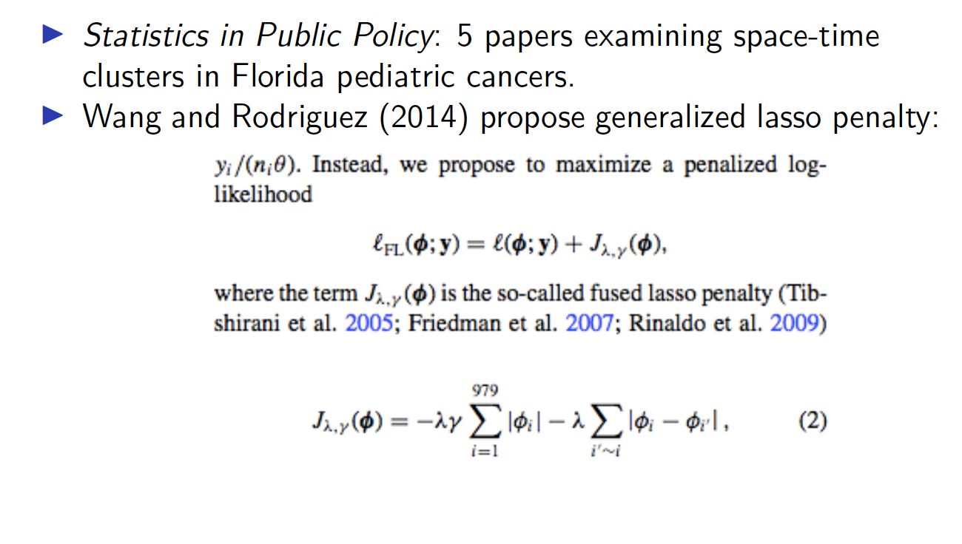
A lightbulb moment…for me

Slide 24
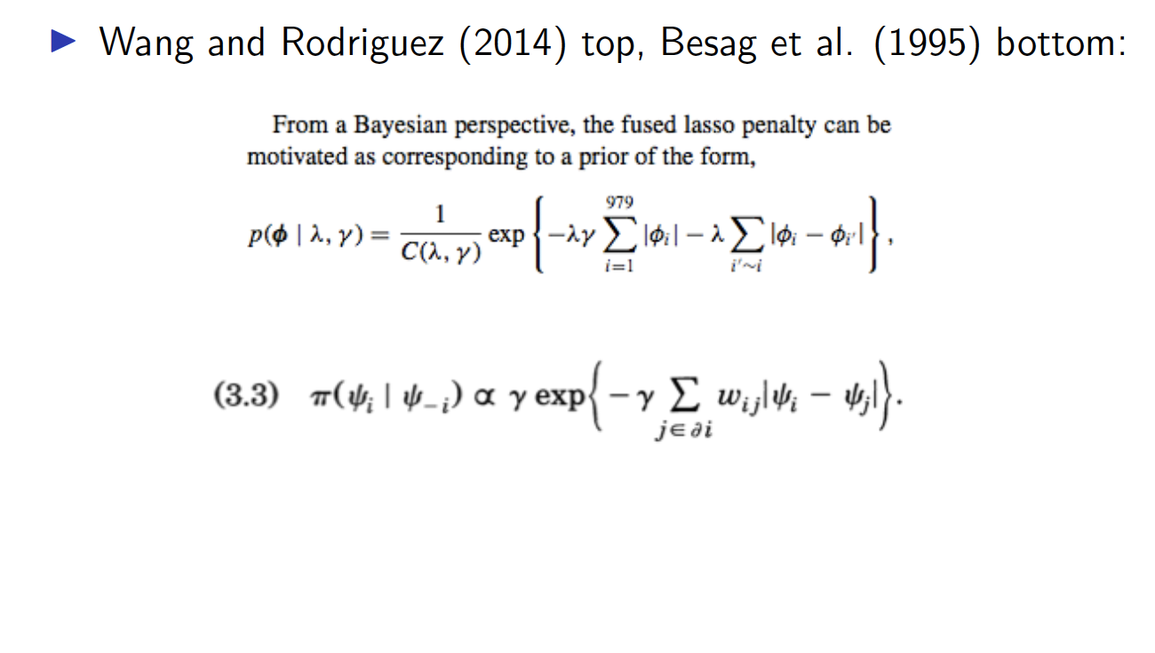
Seemed familiar…

Slide 25
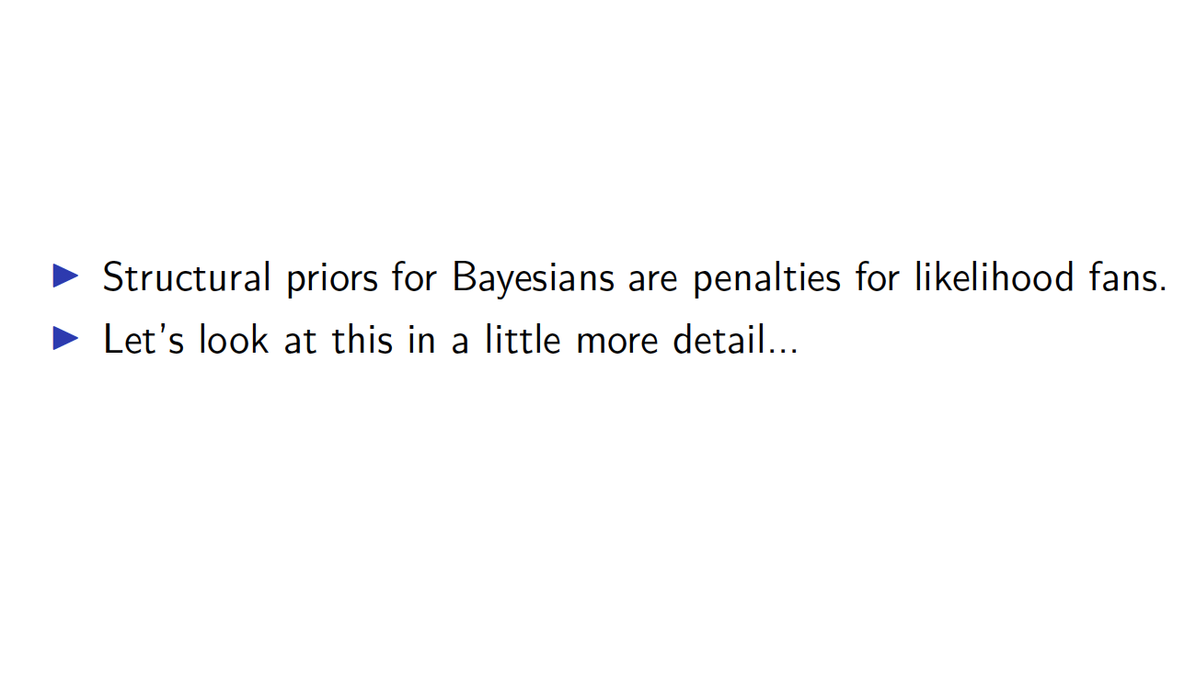
Your penalty is my prior

Slide 26
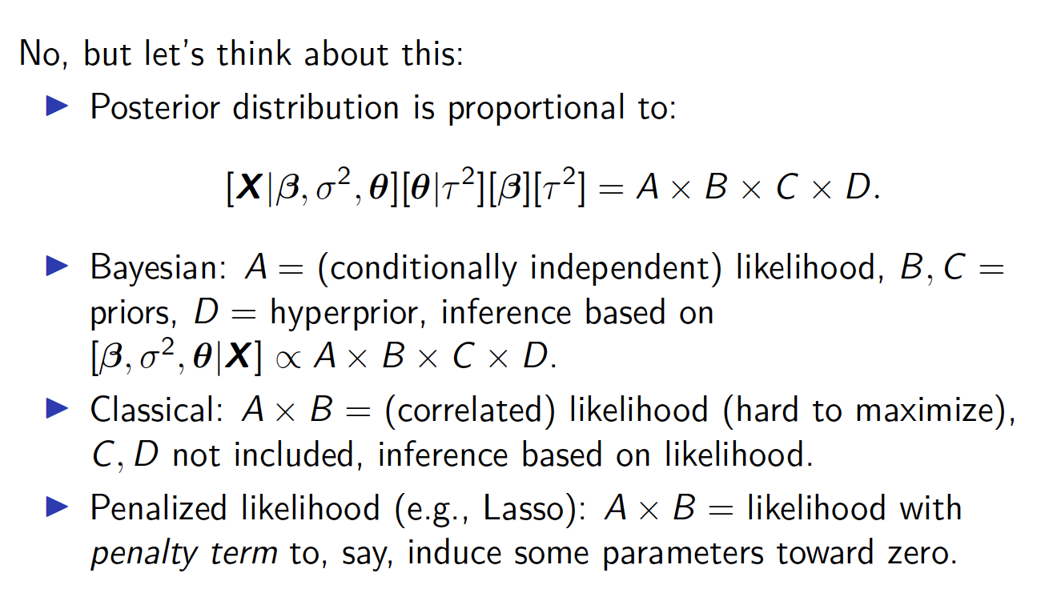
Do I have to be a Bayesian to use random effects?

Slide 27
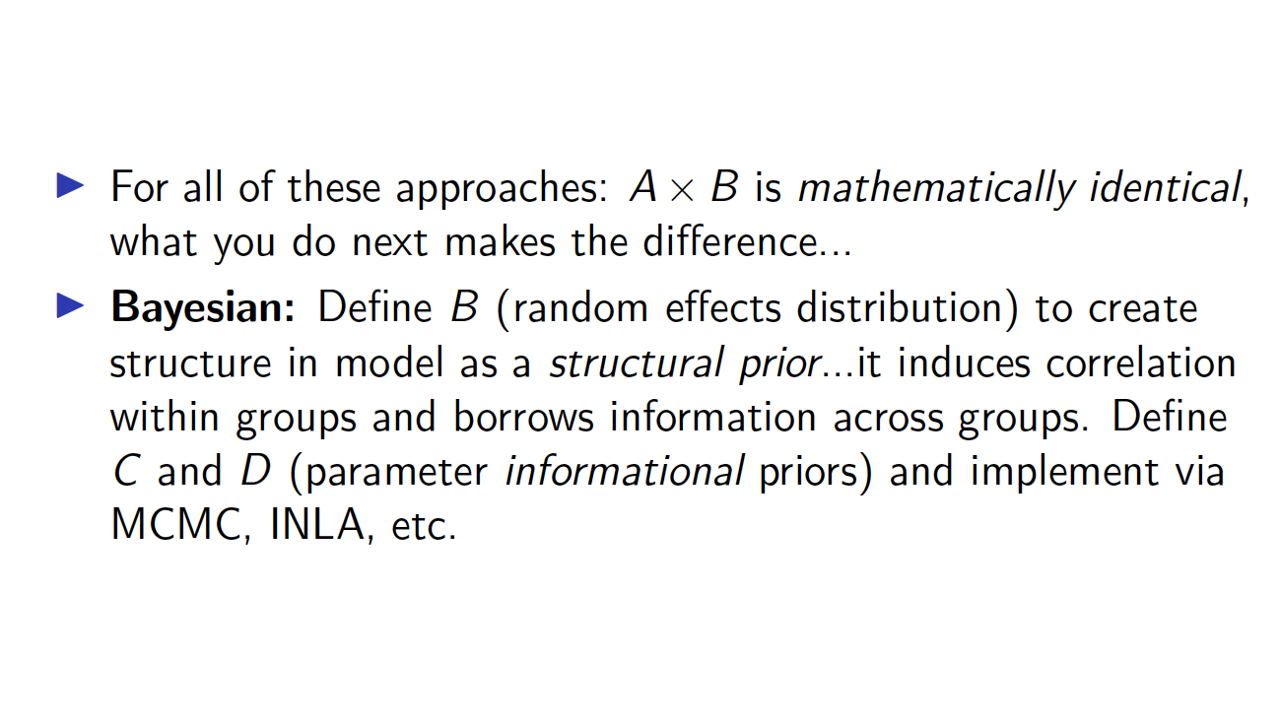
Creating structure through priors and penalties

Slide 28
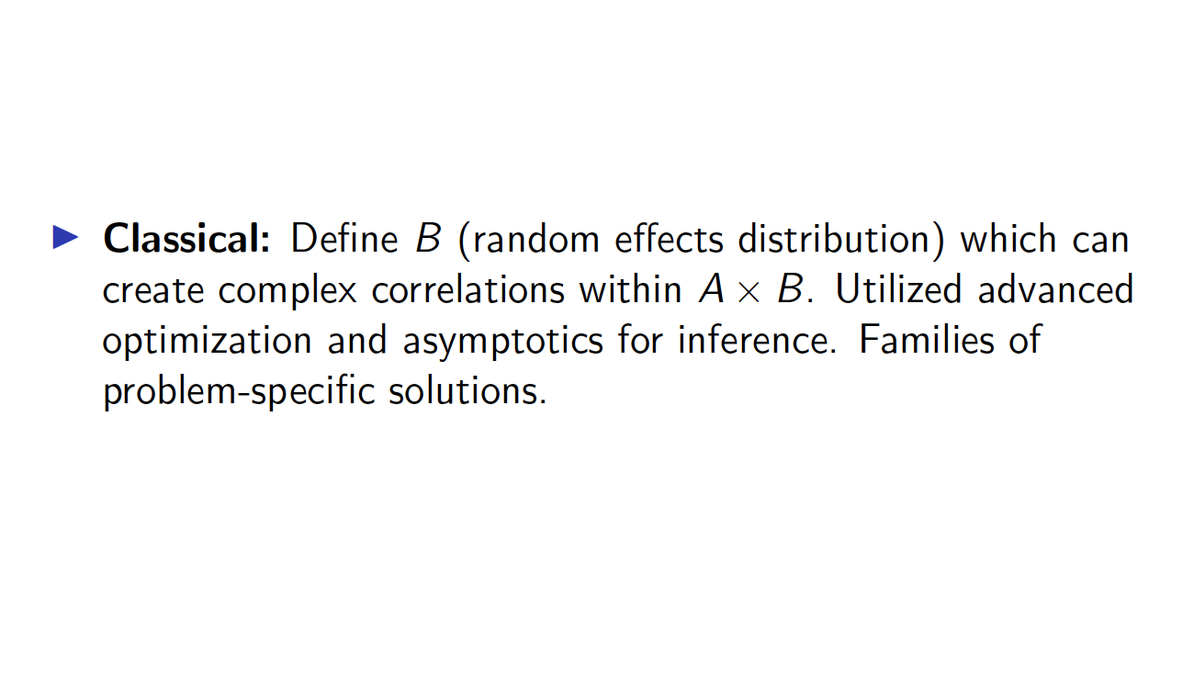
Creating structure through priors and penalties

Slide 29
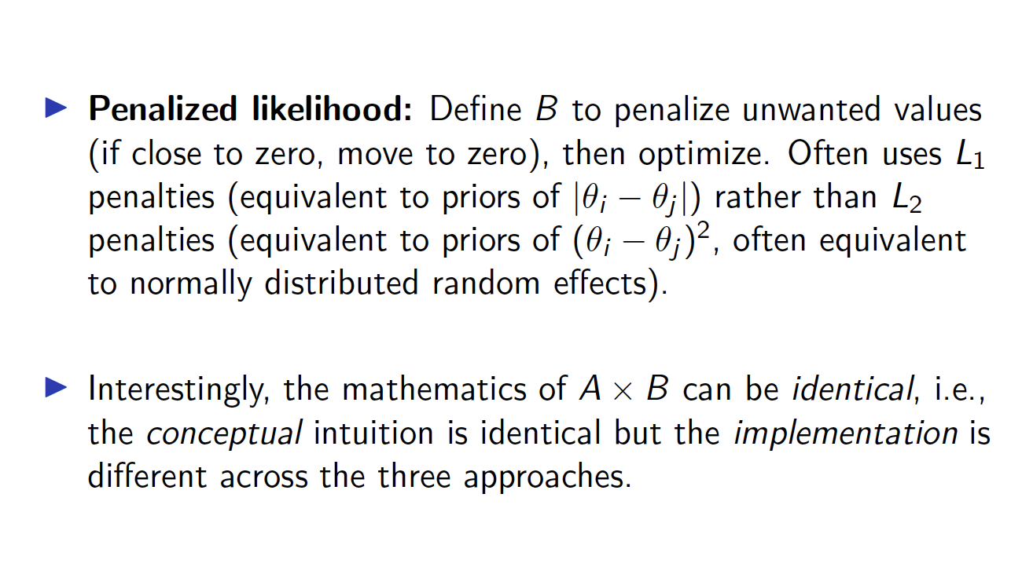
Creating structure through priors and penalties

Slide 30
What else can we do?

Slide 31
Spatially varying associations
Standard regression assumptions:
Independence
Constant variance
Gaussian errors
Linear association between mean and covariates
What if we break rules 1-3?

Slide 32
Fix it or model it?
Fix it:
Weighted least squares for unequal variance
Higher weights on more precise observations.
Geographic weights yield geographically weighted regression.
Higher weights for closer observations.
Fotheringham et al. (2002) Geographically Weighted Regression.
Model it:
Structural priors on slopes to generate spatial variation in associations
Spatially varying coefficients
Leyland et al (2000, Stat Med), Assunção (2003, Environmetrics), Gelfand et al (2003, JASA)

Slide 33
Waller et al. (2007, SERRA)

Slide 34
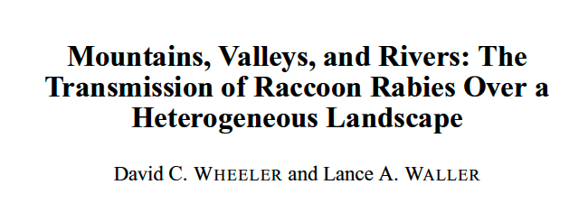
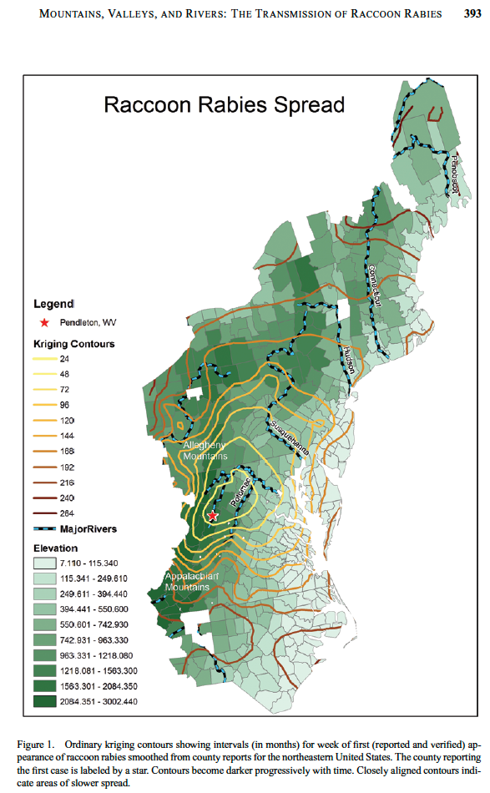
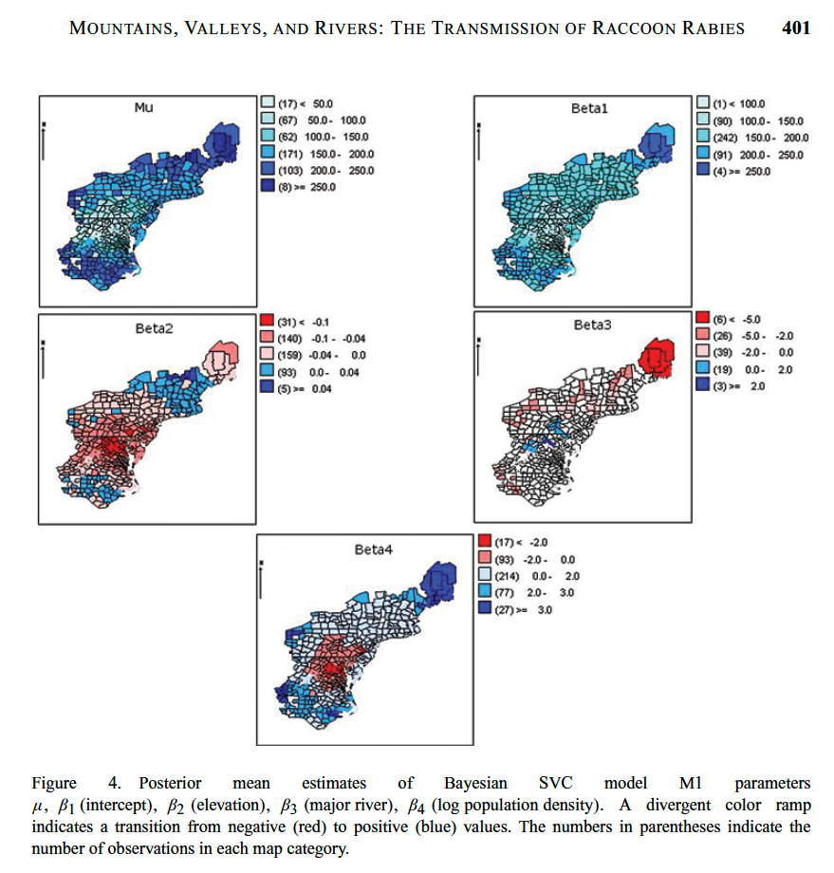

Slide 35
Spatial diagnostics for spatial models
Statistical diagnostics
Residuals
Measures of fit (DIC, AIC, BIC, wBIC)
Power
Sensitivity
Specificity
What if these vary by location?

Slide 36
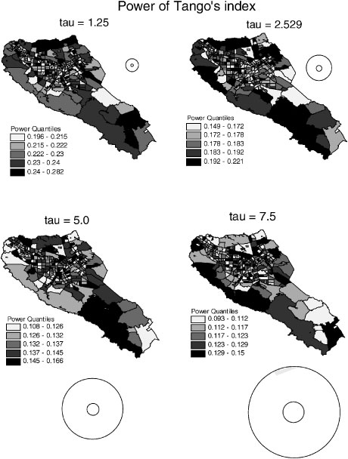
The Geography of Power
Local Power of Tango’s Index
Waller et al. (2006, Statistics in Medicine)

Slide 37
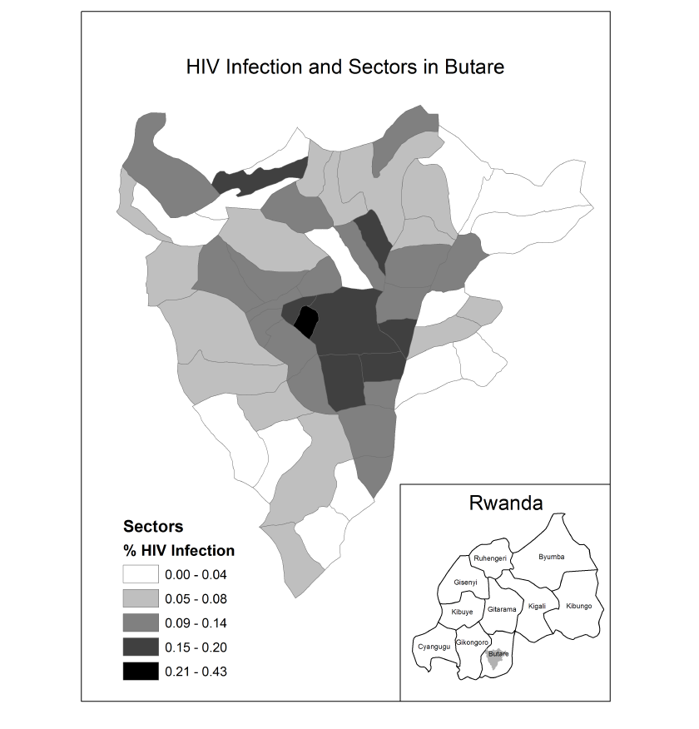
Spatial variations in fit: HIV in Butare, Rwanda
Wheeler et al. (2010) Computational
Statistics and Data Analysis.

Slide 38
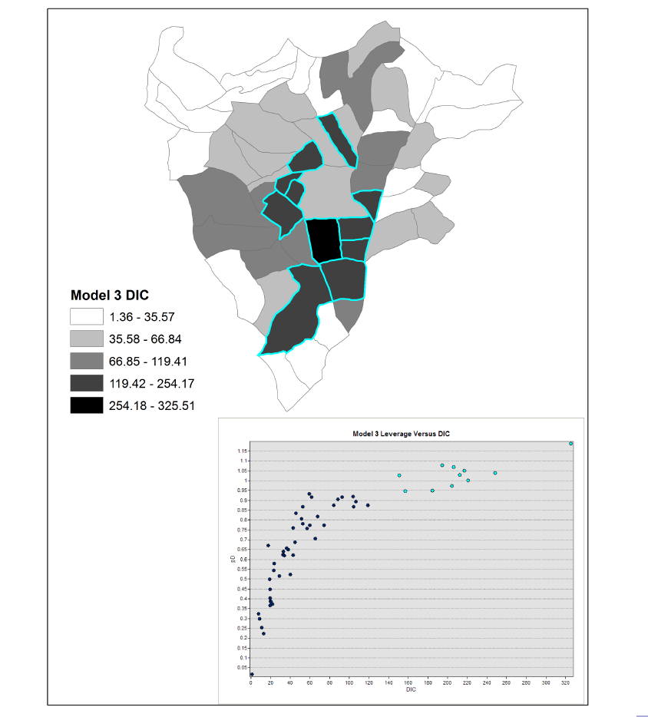
Map components of DIC
Identify locations of outliers.
Identify spatial correlation of outliers
Identify high leverage observations
Wheeler et al. (2010) Computational
Statistics and Data Analysis.

Slide 39
Summary
Maps Fascinate
Motivate questions, drive stories.
Maps Communicate (Maps as Visualization)
Provide geographic context to observed variations.
Maps Integrate (Maps as Data)
Geographic space adds insights that geometric space alone cannot.
Maps Evaluate (Maps as Statistics)
Inference in geographic space, interpretation in geographic space, and spatial perspective on inferential results.

Slide 40
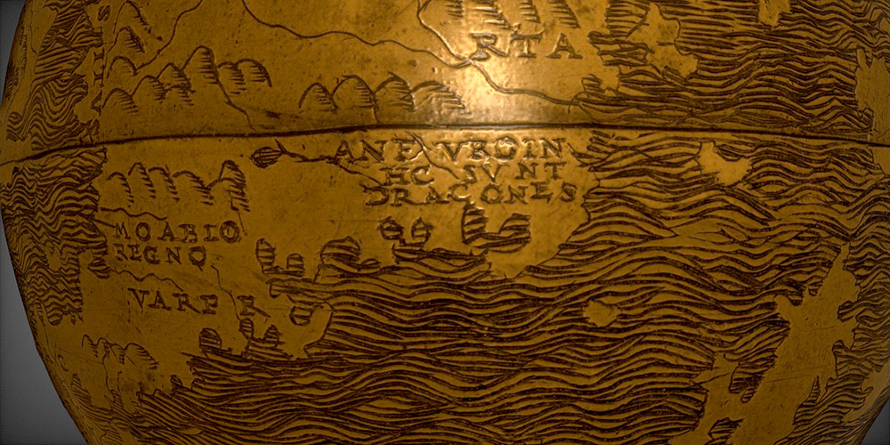
Here be dragons: Questions?
https://www.rochester.edu/newscenter/worlds-oldest-globe-hunt-lenox-lazarus-project-417532/
Hunt-Lenox Globe (NYPL): Online version at Rochester’s Project Lazarus!
https://resurrect3d.lib.rochester.edu/models/5bdc5e604270f527332282dd

